Slide 1
Navigating Handshake
Career Planning & Development

Slide 2
https://app.joinhandshake.com/login
Signing Up For Handshake
2

Slide 3
https://www.caldwell.edu/
Signing In To Handshake
3

Slide 4
Editing Your
Profile
4

Slide 5
Navigating:
My Career
Interests
5

Slide 6
Navigating:
My
Documents
6

Slide 7
Jobs
And
Filters
7

Slide 8
How To See Your
Saved Jobs
8

Slide 9
Navigating: Events
And
Filters
9

Slide 10
Navigating: Career Center
10

Slide 11
Navigating:
My
Jobs
This is also where you will follow up on reviewed and pending jobs.
11

Slide 12
Navigating: Your
Inbox
12

Slide 13
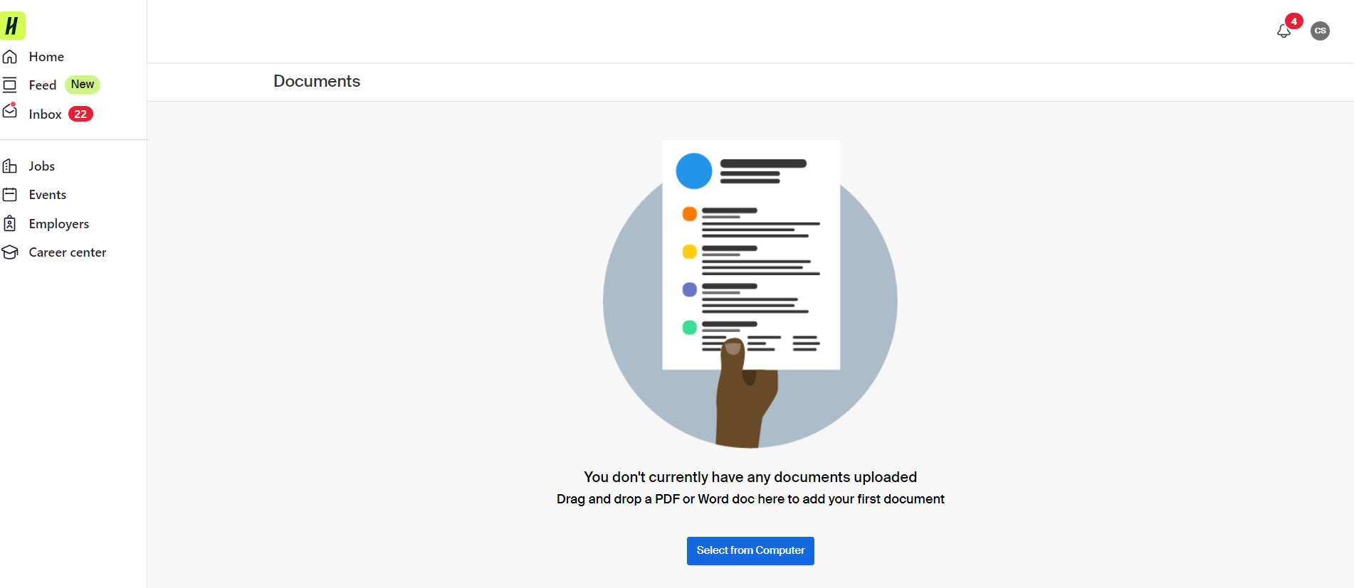
Navigating: My Documents
Navigating: My Documents
continued…
This is what your “my documents” page will look like when you have a new account with nothing uploaded.
You can click on “Select from Computer” to upload your first document.
13

Slide 14
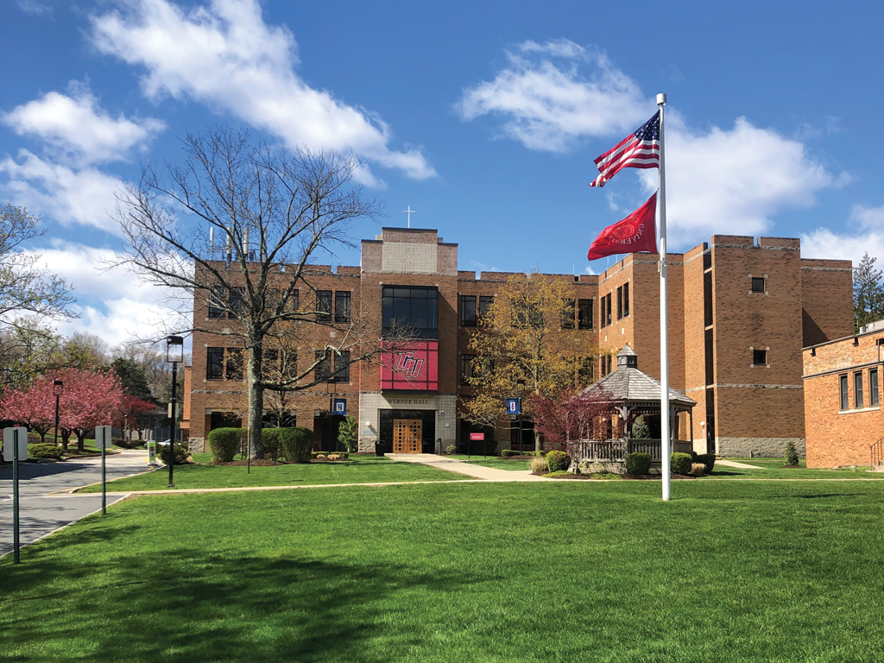
Good Luck!
Book an appointment on Handshake or stop by the career center if you have any questions!
Aquinas Hall, Room 109
973-618-3290
careers@caldwell.edu
Christine Szeluga, Assistant Director: cszeluga@caldwell.edu

